Slide 1

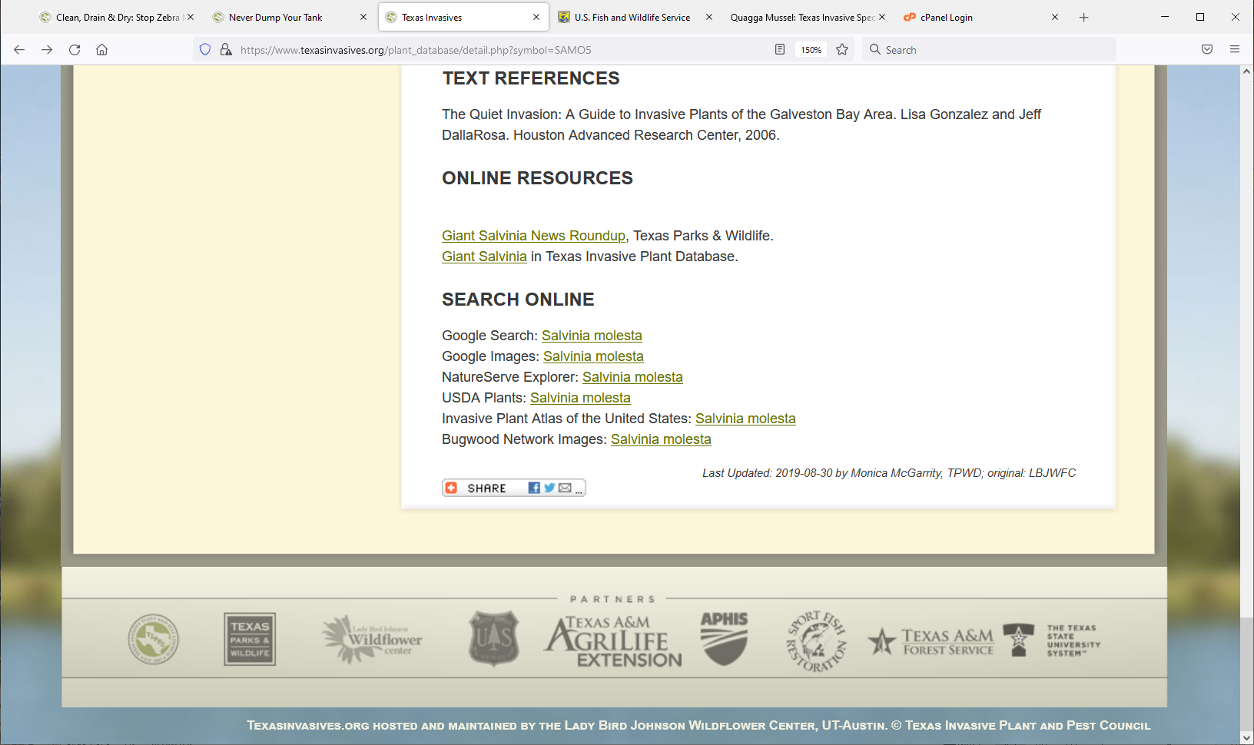
Invasive Mollusks & Crustaceans. Recreational and Human Health Impact
USDA-APHIS
Texas Invasive Species Institute (TISI)
SHSU Agriculture Sciences
SHSU Engineering Technology

Slide 2
TEKS / OBJECTIVES
TEKS: 130.25 16 (A-B) 17 (A-D) The student identifies how plants grow and how specialized cells, tissues, and organs develop. The student diagrams the structure and function of nucleic acids in the mechanism of genetics.
Objectives:
Student will inspect multiple priority pests in the aquatic and terrestrial recreational sites.
Criticize over transmission in humans and preventative education measures.

Slide 3
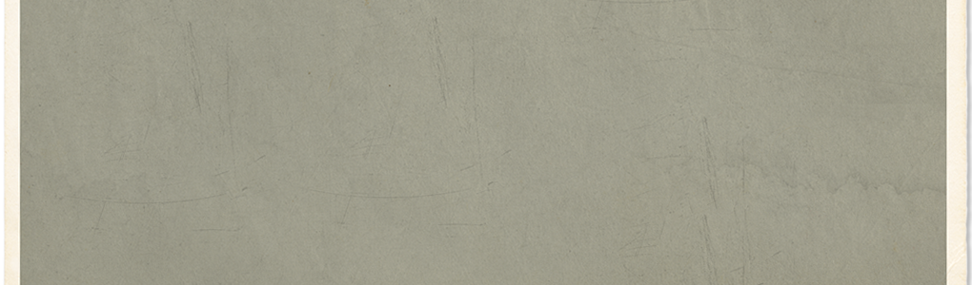
Anticipation Questions
What do you define to be mollusks and crustaceans?
What kind of impacts do crustaceans and mollusks have on humans?
  Do you think their impacts are different or similar to other invasive species groups you have learned about?

Slide 4
What is the price?
Boll Weevils have affected the US Cotton Industry since the 1890s, how much has it cost the US?
Notes:
Price = $50 Billion Dollars

Slide 5
What is the price?
U.S waterways are affected by Invasive Aquatic Plants (Hydrilla and water hyacinth, etc.), how much does management cost annually?
Notes:
Price = 100 Million Annually

Slide 6
What is the price?
U.S Agriculture has lost how much to Invasive Plants since 1900?
Notes:
Price = $30.6 Billion Dollars (Control and Production Losses included)

Slide 7


Engage Research
What types of invasive Mollusks & Crustaceans could hurt us, and how?
Notes:
Think about the ways invasive species can cause harm:
Economic
Eating crops
Ruining gardens
Ecological
Harming water-based ecosystems.
Some eat so much plankton it increases water clarity and temperature killing off native mussels and fishes Harming terrestrial systems by eating more leaflitter than the ecosystem is adapted to.
Invasive slugs
Recreational (Zebra Mussel)

Slide 8

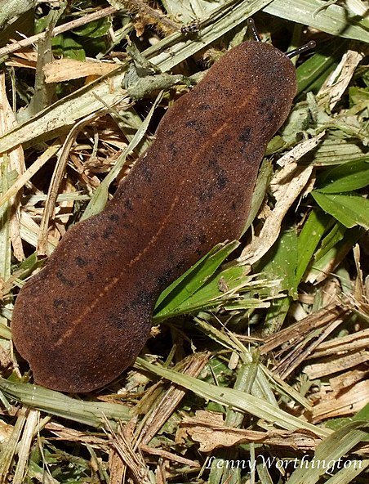
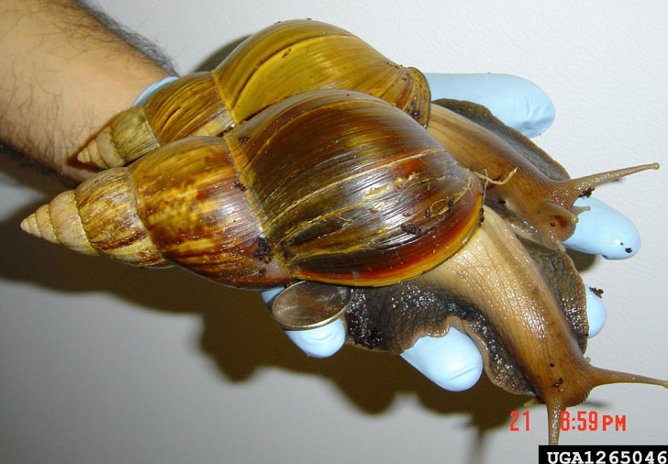
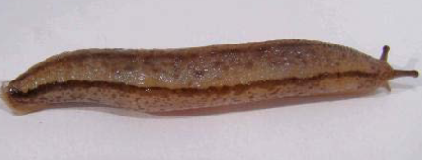
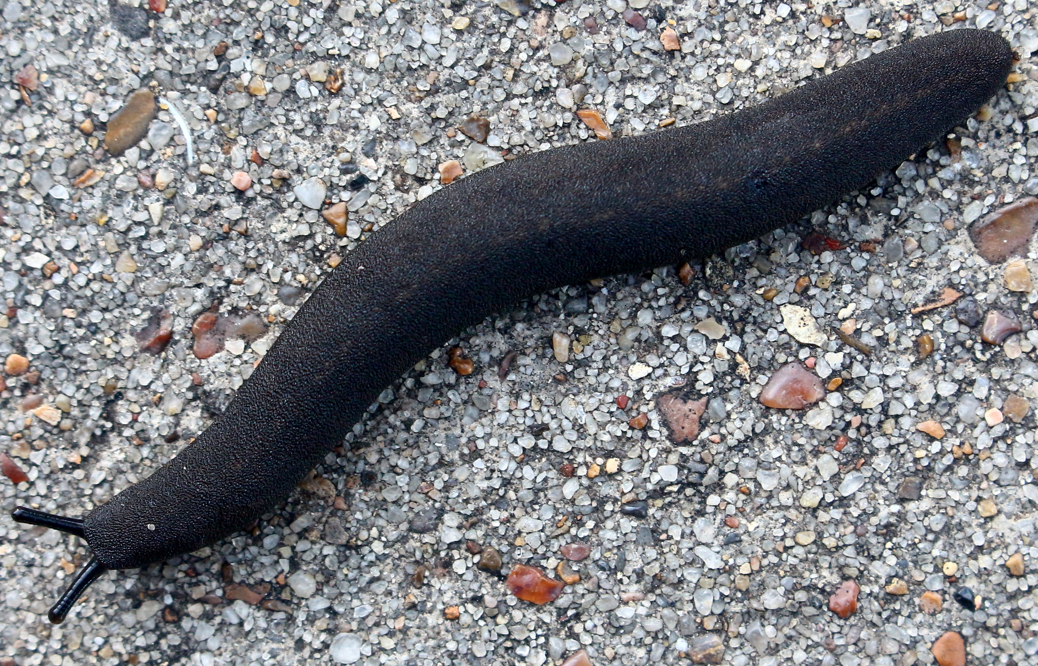
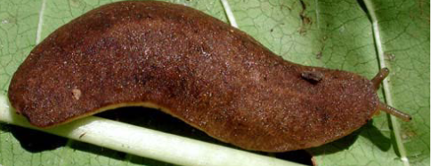
PPA Priority Mollusks
Giant East African Snail Achatina fulica
Laevicaulis spp. slugs
Chinese Land Slug Meghimatium pictum
Leatherleaf Slugs Belocaulus spp.
Sarasinula spp. slugs
Notes:
PHOTOS:
Giant African Snail: Roberta Zimmerman, USDA APHIS, Bugwood.org
Chinese Slug: Paulo Lenhard, Project AM
Leatherleaf slug: Black Velvet Leatherleaf slug pictured; photo by Dr. Matt McClure, TISI Expert
Laevicaulis spp: Len Worthington, Wikimedia Commons
Sarasinula spp.: http://download.ceris.purdue.edu/file/2558
PRONUNCIATION
Achatina = Ach-a-tin-a
Laevicaulis = Lay-vee-call-us
Meghimatium = Meg-he-matt-y-um
Belocaulus = Bey-low-call-us
Sarasinula = Sarah-sin-oola

Slide 9
Parasitic Nematodes
RECALL: The lesson on Soil Nematodes introduced parasitic nematodes.
There are also Nematodes live inside invasive Slugs and Snails.
  If infected with nematodes, they really do become “Killer Slugs” to all kinds of mammals (Rats, Cats, Dogs, Horses, Monkeys, etc.).
  The nematodes we need to be concerned about are Angiostrongylus cantonensis and A. costaricensis.
    THESE SPECIES CAN INFECT HUMANS… NOT FATAL TO US, BUT NOT GOOD!!
Therefore, you should NEVER keep mollusks as pets!
Notes:
Pronunciation of parasites:
“Ann-geo-stron-guy-luss, canton-en-sis” This is from the Canton Region of China.
“Ann-geo-stron-guy-luss, coast-a-rick-en-sis” This is was first described in Costa Rica.
Information on parasites:
https://www.cdc.gov/parasites/angiostrongylus/index.html
https://entnemdept.ufl.edu/creatures/nematode/rat_lungworm.htm
VIDEO ON PARASITES: https://www.cdc.gov/parasites/angiostrongylus/add_resources.html
Rat Lungworm in Hawaii: https://health.hawaii.gov/docd/disease_listing/rat-lungworm-angiostrongyliasis/

Slide 10
Angiostrongylus Present in the United States
Hawaii (A. cantonensis since 1963: Humans)
Florida (A. cantonensis in 2013 and A. costaricensis in 2003)
Louisiana (A. cantonensis since 1988)
Oklahoma (A. cantonensis in 2015)
Texas (A. cantonensis in Humans 2013, 2015, 2020; A. costaricensis in 1979)
  TISI Study showing Angiostrongylus in invasive slugs from natural and urban areas)
Notes:
Main point is the parasites ARE HERE!
This slide lists which species of the nematode have been found in the states. Data is gathered from scientific research publications.
It also lists which animal it was found in (mollusk vs. human vs. Rat, etc.)
FLORIDA MOLLUSK was Giant African Snail; infected primates and marsupials at Miami Zoo.
LOUISIANA MOLLUSK was Pomacea Apple Snails (discuss later in the lesson); found in New Orleans Gretna Area
OKLAHOMA: Found in native Cotton Rats in McCurtain County.
TEXAS: A. costaricensis found in 1979 was in a Cotton Rat. The Human cases were reported from Houston and were isolated incidents. TISI is finding the nematodes in this invasive slugs.
EASILY PREVENTABLE. Strategies discussed on the next page.

Slide 11
Prevention of Angiostrongylus
Angiostrongylus cantonensis & A. costaricensis.
  THESE SPECIES CAN INFECT HUMANS… NOT FATAL TO US, BUT NOT GOOD!!
How to prevent infection?
  WEAR GLOVES when handling slugs. The nematodes must enter our digestive tract to cause infection- this is preventable!
    WASH YOUR HANDS! Humans get accidentally infected if they bare-handle an infected slug and touch their mouths afterwards with the dirty hand (allowing access to digestive tract).
  REMOVE invasive mollusks from your property.
  WASH any garden vegetables & fruits (in case infected slugs crawl on them)
  DO NOT keep slugs or snails as pets.
Notes:
Pronunciation of parasites:
“Ann-geo-stron-guy-luss, canton-en-sis” This is from the Canton Region of China.
“Ann-geo-stron-guy-luss, coast-a-rick-en-sis” This is was first described in Costa Rica.
Information on parasites:
https://www.cdc.gov/parasites/angiostrongylus/index.html
https://entnemdept.ufl.edu/creatures/nematode/rat_lungworm.htm
VIDEO ON PARASITES: https://www.cdc.gov/parasites/angiostrongylus/add_resources.html
Rat Lungworm in Hawaii: https://health.hawaii.gov/docd/disease_listing/rat-lungworm-angiostrongyliasis/

Slide 12
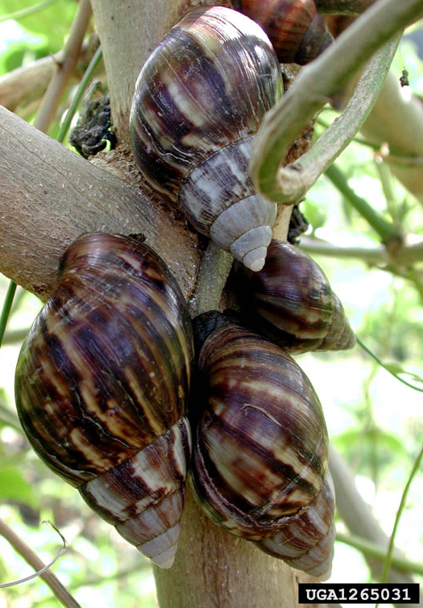
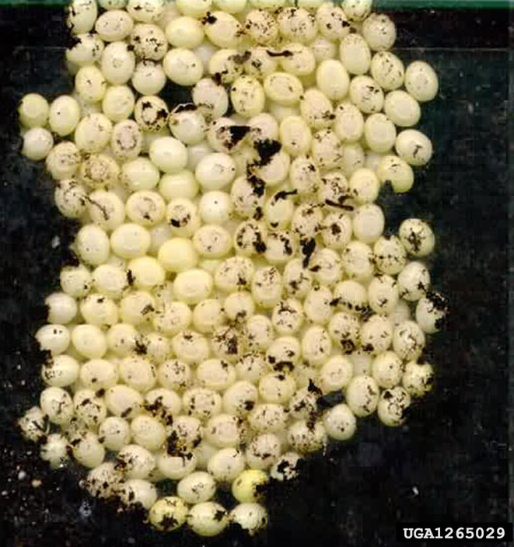
Giant East African Snail
Achatina fulica
Report It!
Native to: East Africa
Crop Hosts: Feeds on 500 types of plants/crops like peanuts, beans, cucumbers and melons.
Economic & Health Impacts
  Introduced into Florida in 1960s by a traveler.
    10 years and $1 Million to eradicate
    Re-introduced in 2011 and another 10 years & $23 Million to re-eradicate.
  Meanwhile, spreads harmful invasive parasites (especially in Hawaii).
    A. cantonensis “Rat Lungworm”
    REMEMBER PREVENTION STRATEGIES!
ILLEGAL to posses/sell in the US
Notes:
Achatina fulicaPRONUNCIATION
Achatina fulica = Ach-a-tin-a ful-lee-cah
TISI, TPWD, USDA-APHIS and USGS are actively tracking this species. The REPORT IT! icon is linked to our reporting form: https://www.texasinvasives.org/action/report_detail.php?alert_id=17
RESOURCES:
https://www.invasivespeciesinfo.gov/terrestrial/invertebrates/giant-african-snail
http://www.tsusinvasives.org/home/database/lissachatina-fulica
https://firstdetector.org/giant-african-snail
https://www.aphis.usda.gov/aphis/resources/pests-diseases/hungry-pests/the-threat/giant-african-snail/giant-african-snail
https://infonet-biovision.org/PlantHealth/Pests/Snails-Giant-East-African-Snail#:~:text=The%20Giant%20East%20African%20Snail%20Achatina%20fulica%2C%20is,wide%20range%20of%20plant%20material%2C%20fruit%20and%20vegetables.
2021 Eradication in Florida: https://www.aphis.usda.gov/aphis/ourfocus/planthealth/plant-pest-and-disease-programs/pests-and-diseases/giant-african-snail/gas
PHOTOS:
Roberta Zimmerman, USDA APHIS, Bugwood.org
Snails in tree: David G. Robinson, USDA APHIS PPQ, Bugwood.org
Eggs: Yuri Yashin, achatina.ru, Bugwood.org

Slide 13
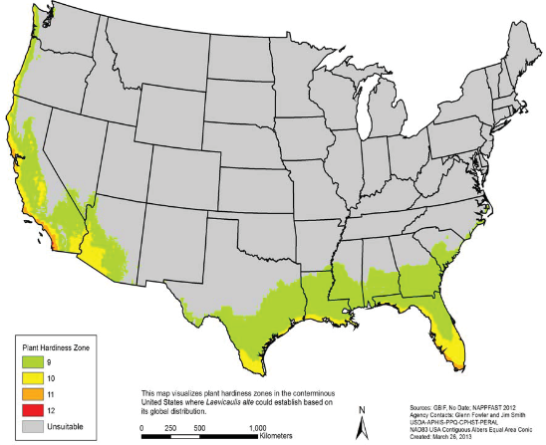
Laevicaulis spp.
Laevicaulis alte
Native to: Central Africa
Crop Hosts: Feeds on over 40 types of crops like cabbage, tomatoes, spinach beans and cucumbers.
How can it spread? Hitchhikers in the landscaping industry on ornamentals, nursery stock, and cut flowers.
Identification: Rough, leathery brown skin with some spotting and light orange line down the back.
Economic & Health Impacts
  Carries A. cantonensis in Japan
  Feeding on multiple crop species increases its economic impact.
Notes:
PRONUNCIATION:
Laevicaulis alte = Lay-vee-call-us all-tee
Map shows which plant zones (9 & 10) that are likely to host L. alte if it becomes introduced to those states.
http://download.ceris.purdue.edu/file/2554
https://www.gbif.org/species/165489517
Laevicaulis sp.

Slide 14
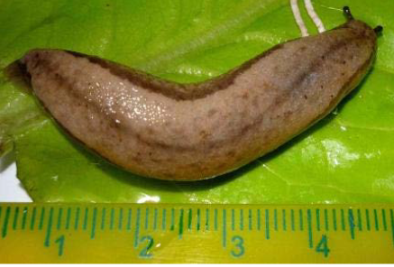
Chinese Land Slug
Meghimatium pictum
Native to: China
Crop Hosts: Feeds on many plants and documented to destroy grape vineyards in Brazil.
How can it be spread? International trade. Found on produce from Brazil; and other ornamental plants from Asia.
Identification: Slimy beige skin that has two lateral stripes and another middle stripe.
Economic & Health Impacts
  Other Megahimatium slugs spread A. cantonensis
  TX Wine Production is threatened if this slug establishes.
Notes:
PRONUNCIATION:
Meghimatium = Meg-he-matt-y-um pick-tum
RESOURCES:
http://download.ceris.purdue.edu/file/2556
https://blog.invasive-species.org/2019/07/19/potential-slug-invasions-and-their-impact-on-uk-biosecurity-part-1/
Research publication about the species: Not required to read beforehand. https://www.researchgate.net/publication/261975471_A_Newly_Introduced_and_Invasive_Land_Slug_in_Brazil_Meghimatium_pictum_Gastropoda_Philomycidae_from_China#:~:text=The%20land%20slug%20Meghimatium%20pictum%20%28Stoliczka%2C%201873%29%2C%20native,analysis%20of%20the%20cytochrome%20oxidase%20subunit%20I%2C%20COI.

Slide 15
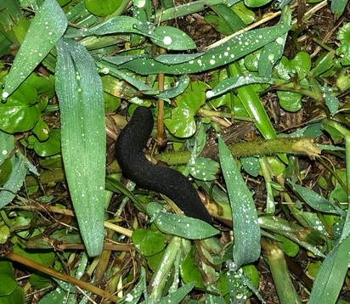
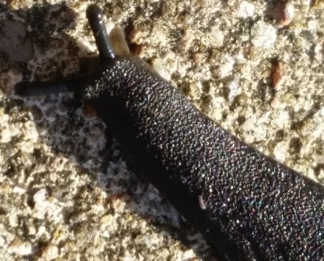
Leatherleaf Slugs
Belocaulus angustipes
Report It!
One species in US
  Common Name: Black Velvet Leatherleaf slug
Native to: South America
  Texas: first reported in the San Antonio area; now found in over 50 Texas counties
How can it spread? Landscaping accidentally spread it across Southeastern US in ornamentals, nursery stock, soil, and mulch.
Identification: Rough “velvet-like” skin that is black throughout. Very distinctive. Underside has beige coloring. Eggs are clear orbs.
Economic & Health Impacts
  Spreads A. costaricensis in Central & South America.
  Large appetite for grasses and turf.
Notes:
Belocaulus = Bey-low-call-us
Belocaulus angustipes = Bey-low-call-us ann-gus-tips
Photos contributed by TISI Citizens reporting their expansion in Texas.
TISI is actively documenting the spread of this species in TX. REPORT IT! Icon links to our webpage for more information on distribution and how to report it: http://stoppinginvasives.org/home/database/belocaulus-angustipes
Other Resources:
https://idtools.org/id/mollusc/factsheet.php?name=Veronicellidae:%20Belocaulus%20angustipes
http://download.ceris.purdue.edu/file/2550
https://entnemdept.ufl.edu/creatures/misc/gastro/slugs_of_florida.htm

Slide 16
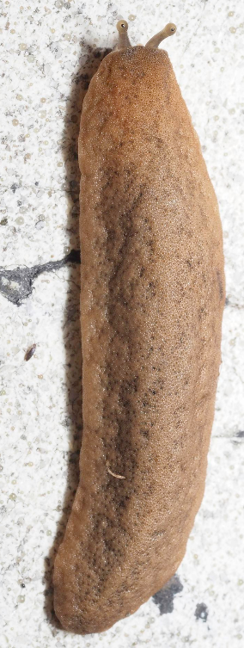
Sarasinula spp.
Sarasinula plebiea
Native to: South America
Crop Hosts: Numerous plants and crops including beans, broccoli, peppers, cucurbits and tomatoes.
How can it spread? Through international trade. It has been intercepted a over 110 times on 37 different plant genera.
Identification: Rough, leathery brown/beige skin with NO pale line. Eyes are at tips of brown antennae, and underside is beige.
Economic & Health Impacts
  Spreads A. costaricensis in Central & South America.
  Feeding on multiple crops increases its economic impact- and TX is susceptible.
Notes:
PRONUNCIATION:
Sarasinula = Sarah-sin-oola
http://download.ceris.purdue.edu/file/2558
https://www.gbif.org/species/2293772
Second photo: Sarasinula plebeia (P.Fischer, 1868) Observed in Chinese Taipei by 周業偉

Slide 17
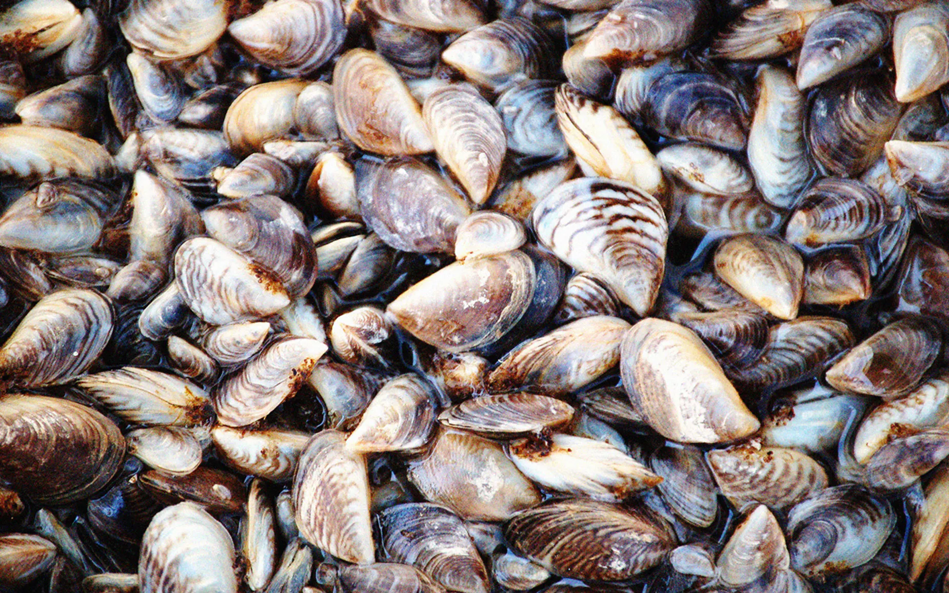
Invasive Mollusks Present in Texas
Zebra Mussels
Yellow Garden Slug
Giant Garden Slug
Pomacea Apple Snails
Red-rim Melania
New Guinea Flatworm
Zebra Mussels
Notes:
https://www.texasmonthly.com/travel/zebra-mussels-texas-lakes/

Slide 18
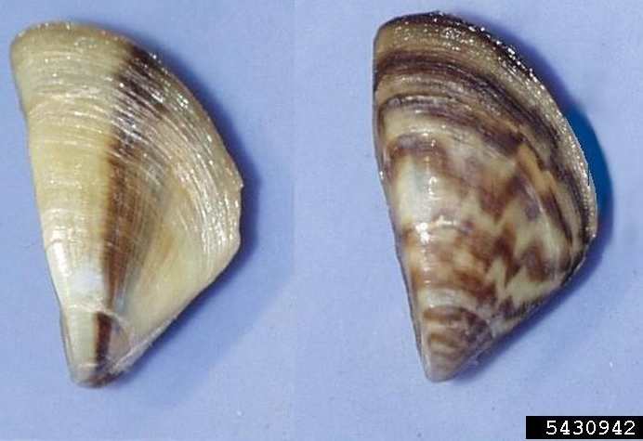
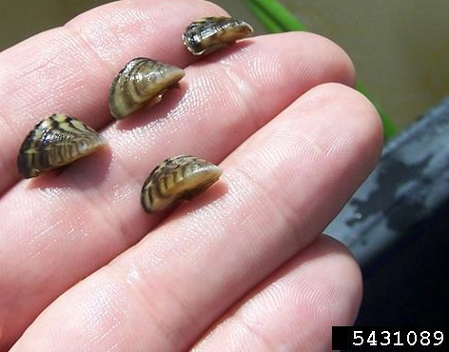
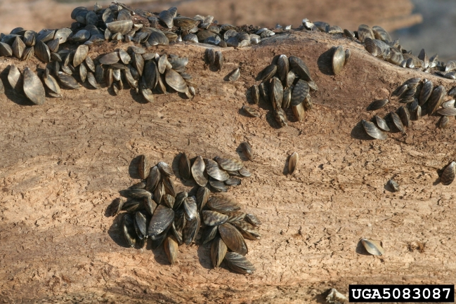
Zebra Mussels
Dreissena polymorpha
Report It!
Native to: Caspian and Black Seas
How can it spread? Introduction directly linked to ballast water from international cargo ships.
  Spread throughout the US by recreational boaters and fishermen. Main reason for Clean, Drain, Dry program.
    Mandatory in TX or $500 fine. Now in 28 Texas Lakes
Identification: Small mussel (1-2in.) with distinct flat-bottom “D-shaped” shell. Larvae (veligers) are microscopic.
Economic & Recreation Impacts
  “Biofouling”: They firmly attach rocks, docks, boats or native mussels.
    Costs Water & Electric municipalities $3.1 Billion in damage & repairs.
  Lowers water quality, harming native species and leads to lake closures.
  ILLEGAL to posses/sell in Texas.
Notes:
PRONUNCIATION:
Dreissena = Dray-sen-a
Zebra Mussels are one of the most infamous invasive species because of their accidental introduction to the US through international trade. Because they went unnoticed, they were then spread by recreational boaters and fishermen. This is how it spread to 28 TX Lakes and why CLEAN DRAIN DRY is so important. TPWD has instituted a $500 fine for people that are not properly cleaning their equipment when leaving lakes.
TISI, TPWD, USDA-APHIS and USGS are actively tracking this species. The REPORT IT! icon is linked to our reporting form: https://www.texasinvasives.org/action/report_detail.php?alert_id=2
PHOTOS:
Top-photo: Amy Benson, U.S. Geological Survey, Bugwood.org
Middle Photo: Michael Massimi, Barataria-Terrebonne National Estuary Program, Bugwood.org
Bottom Photo: Whitney Cranshaw, Colorado State University, Bugwood.org
RESOURCES:
https://www.texasinvasives.org/animal_database/detail.php?symbol=10
https://www.fws.gov/fisheries/ANS/zebra-mussel.html
https://www.nps.gov/articles/zebra-mussels.htm
https://www.invasivespeciesinfo.gov/aquatic/invertebrates/zebra-mussel
https://www.texasmonthly.com/travel/zebra-mussels-texas-lakes/
ECONOMIC DATA: $3.1 Billion over 10 years: https://2001-2009.state.gov/g/oes/ocns/inv/cs/2304.htm

Slide 19
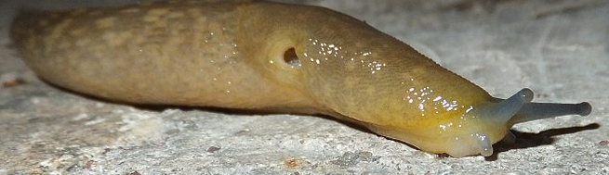
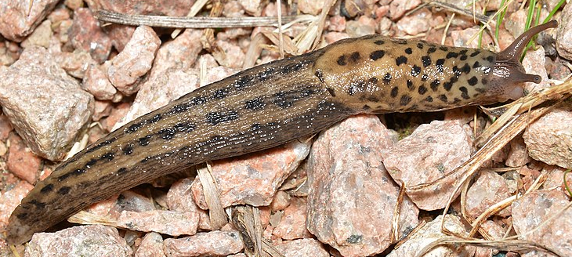
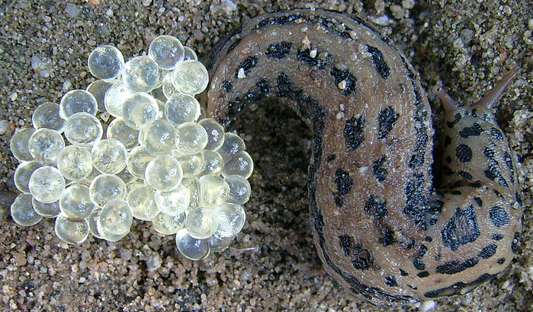
Yellow Garden & Giant Garden slugs
Limax flavus & Limax maximus
Native to: Europe, N. Africa & Asia Minor.
Yellow Garden Slug: (L. flavus) & Giant Garden Slug: (L. maximus). Both species in U.S. since 1860s; up to 40 states.
Identification: Mantled slugs that have a breathing-pore.
L. flavus is yellow with spotting and blue antennae.
L. maximus has leopard-like spotting with brown antennae.
How does it spread? Through the landscaping industry.
Ecological & Health Impacts:
Both can spread Angiostrongylus nematodes.
Ecological impact: Highly competitive against native slugs and known to reduce populations.
Breathing pore
Mantle section
Notes:
PRONUNCIATION:
Limax = Lie-max
Both species are found throughout Texas, and we strongly encourage disposal. These slugs are the perfect example of an invasive species adapting and being able to help a native parasite spread even farther.
Limax flavus-https://commons.wikimedia.org/wiki/File:Limax_flavus_Piazzo_03.jpg
Limax maximus - https://commons.wikimedia.org/wiki/File:Leopard_Slug_(Limax_maximus)_-_Oslo,_Norway_2020-09-13.jpg
Maximus with clear eggs-https://commons.wikimedia.org/wiki/File:Tigerschnegel_Eiablage.jpg
RESOURCES:
http://stoppinginvasives.org/home/database/limax-flavus
http://stoppinginvasives.org/home/database/limax-maximus
https://idtools.org/id/mollusc/factsheet.php?name=Limacus%20flavus
https://www.gbif.org/species/2295442
https://idtools.org/id/mollusc/factsheet.php?name=Limax%20maximus
https://www.gbif.org/species/2295438

Slide 20
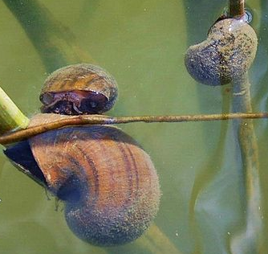
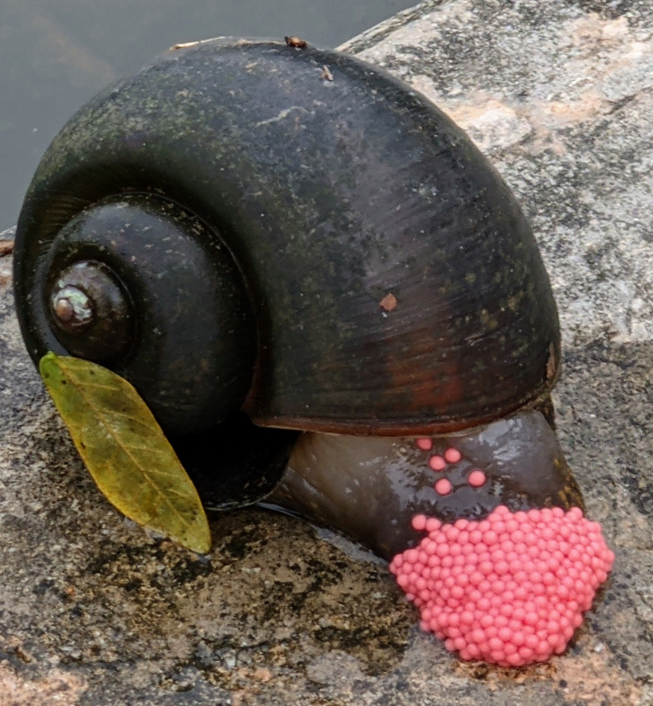
Island Apple Snail
Pomacea maculata
Report It!
Native to: South America
How can it spread? Through the pet trade and started with aquarium dumps in Florida. In Texas since 2000, and in 11 watersheds.
Identification: Resembles no native species.
  Large Freshwater snail (~2-4inches)
    Adults are fully aquatic.
  Distinctive bright pink eggs
    Found above waterline on nearby plants, drainage, walls, etc.
Economic & Health Impacts
  Great economic damage on rice crops
  Ecological imbalance by competing with native snails.
  Can spread A. cantonensis in Florida, Hawaii & Louisiana.
  ILLEGAL to posses/sell in Texas.
Notes:
PRONUNCIATION:
Pomacea= Poe-may-see-uh
Apple snails have spread through the US because of the pet/aquarium trade and subsequent “dumps” when people move or change interests. Besides the Giant African Snail, this snail seems to be one of the most successful carriers of the Rat Lungworm.
They are VERY hard to eradicate once well-established so it is very important to manage any that you see (removal strategies will be discussed in a couple slides).
TISI, TPWD and USGS are actively tracking this species. The REPORT IT! icon is linked to our reporting form: https://www.texasinvasives.org/action/report_detail.php?alert_id=20
RESOURCES:
http://stoppinginvasives.org/home/database/pomacea-maculata
https://nas.er.usgs.gov/queries/FactSheet.aspx?SpeciesID=2633
https://www.fwgna.org/species/ampullariidae/p_insularum.html
https://invasions.si.edu/nemesis/species_summary/-503#:~:text=Pomacea%20maculata%20is%20a%20large%20freshwater%20snail%20commonly,freshwater%20regions%20of%20Florida%2C%20Alabama%2C%20Louisiana%2C%20and%20Texas.
PHOTOS:
Snails underwater: Jess Van Dyke, Snail Busters, LLC, Bugwood.org though Wikimedia Commons.
Snail laying eggs: Jpatokal via Wikimedia Commons

Slide 21
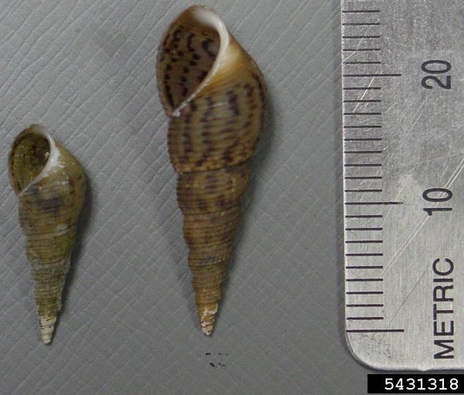
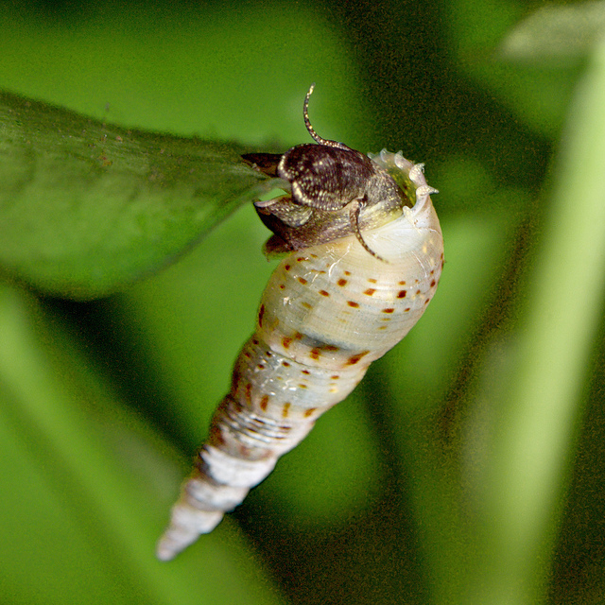
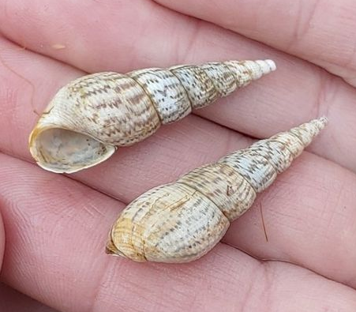
Red-rim Melania
Melanoides tuberculata
Native to: Africa and Asia
How can it spread? Used in the aquarium trade. Accidentally introduced to waterways in 1930s.
  Then can spread by predatory animals.
Identification:
  Small Freshwater snail (17-24mm) with spiraled shell
  Light brown or cream in color with darker speckles.
  The tips of their shells break often.
Economic & Health Impacts
  Spreads a different kind of parasite called trematodes to mammals and birds.
    Avoid eating undercooked fish or crabs from waters where Red-rim Melania is present.
  Melanoides reduce native snail & benthic fish populations through egg consumption.
Notes:
RESOURCES:
http://stoppinginvasives.org/home/database/melanoides-tuberculata
https://pubs.usgs.gov/fs/2008/3006/pdf/fs2008-3006.pdf
http://smmercury.com/2012/01/25/invasive-snail-parasite-threaten-central-texas-fish-stocks/
https://nas.er.usgs.gov/queries/FactSheet.aspx?SpeciesID=1037
https://www.gbif.org/species/4362965
PHOTOS:
Amy Benson, U.S. Geological Survey, Bugwood.org
https://www.animalspot.net/melanoides-tuberculata.html
Thomas Herman, https://www.inaturalist.org/photos/125553867

Slide 22
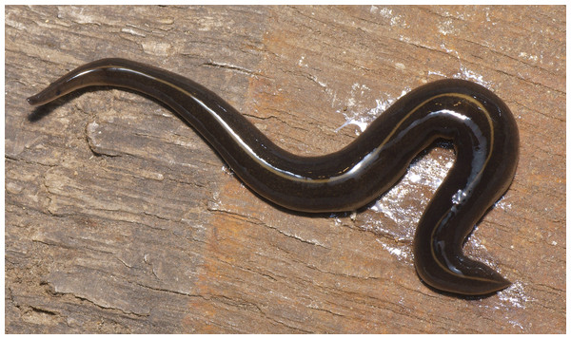
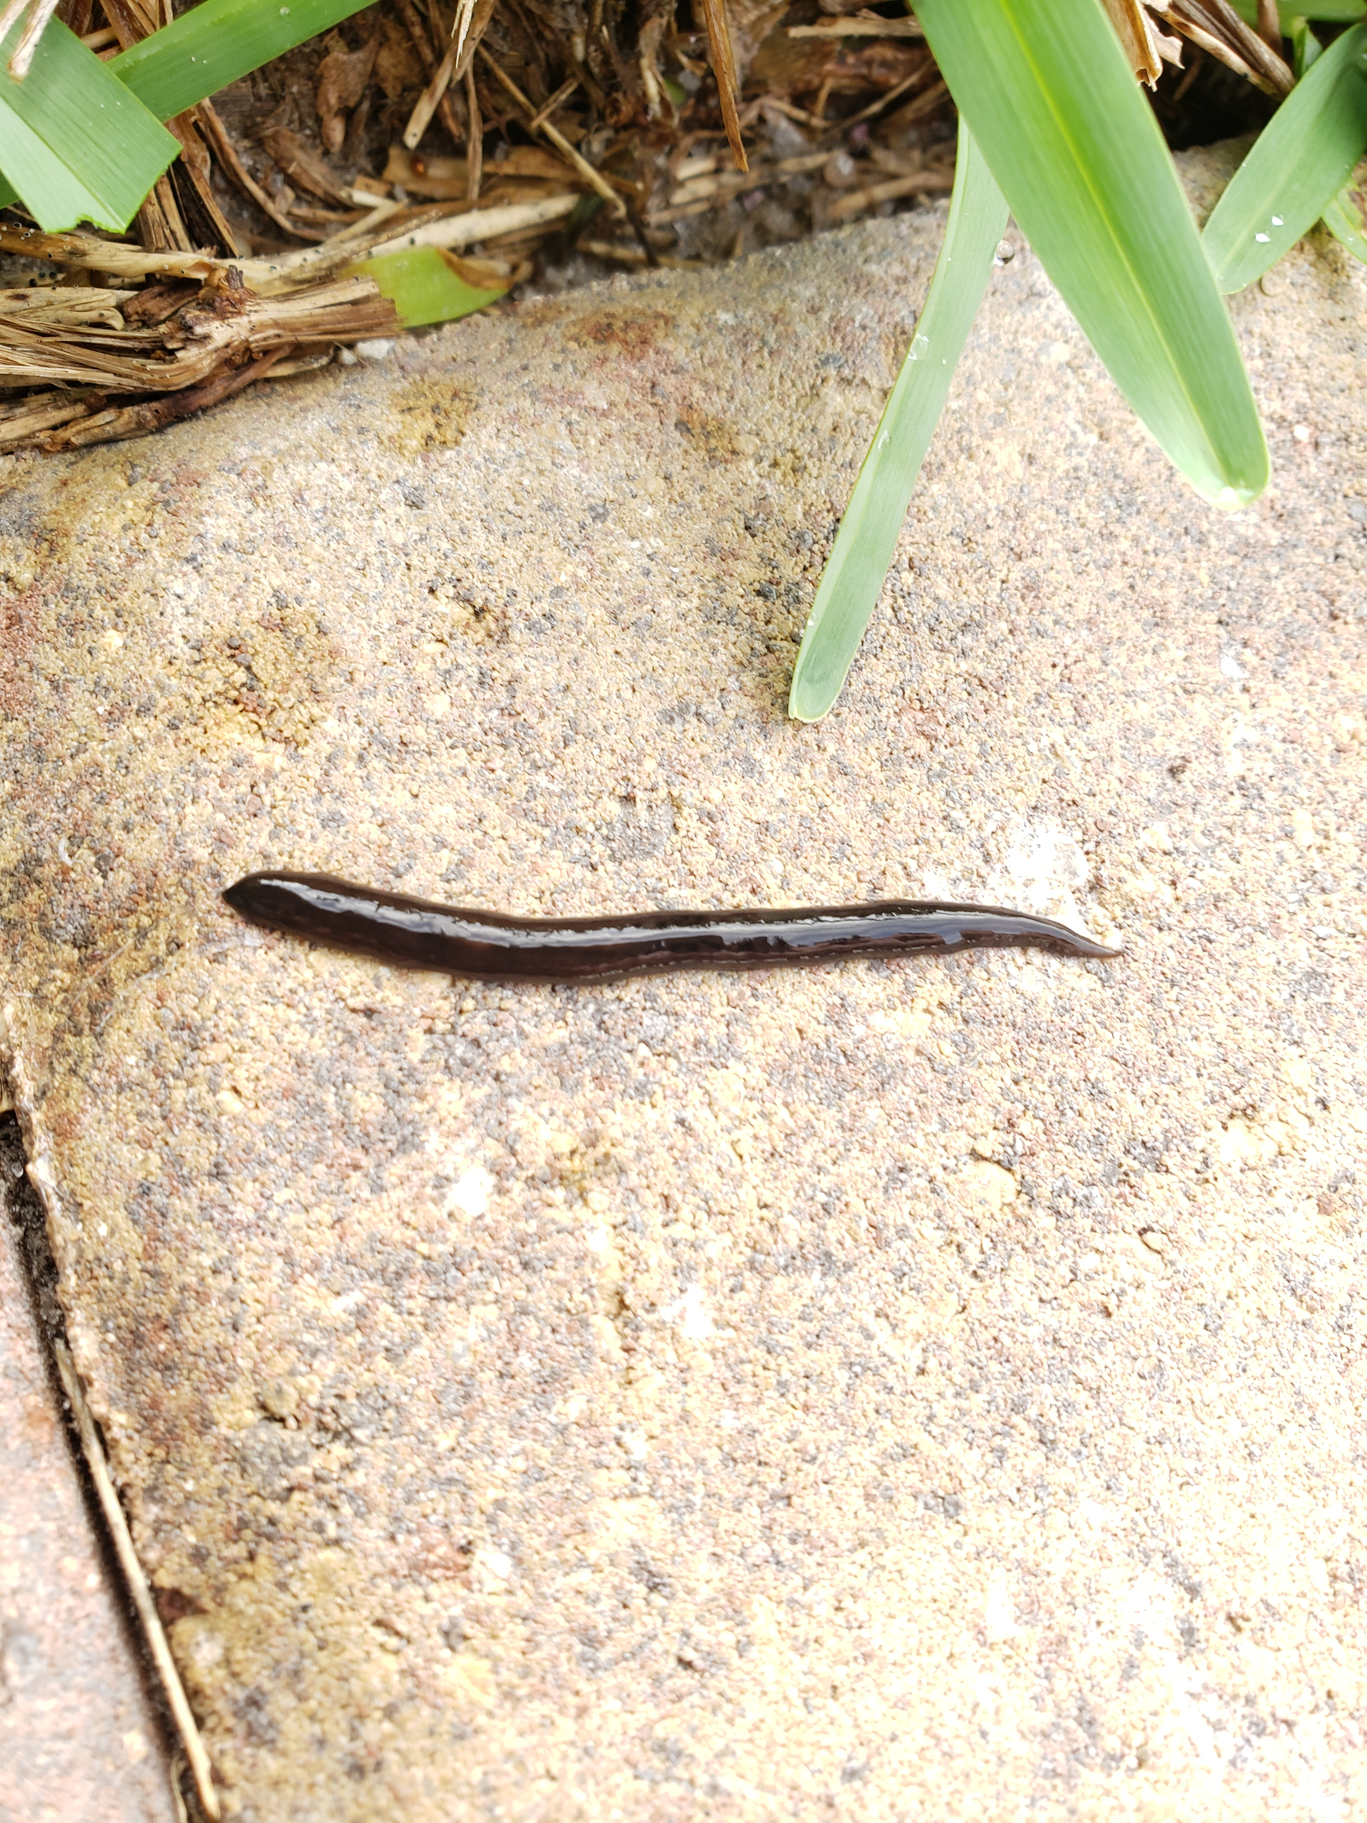
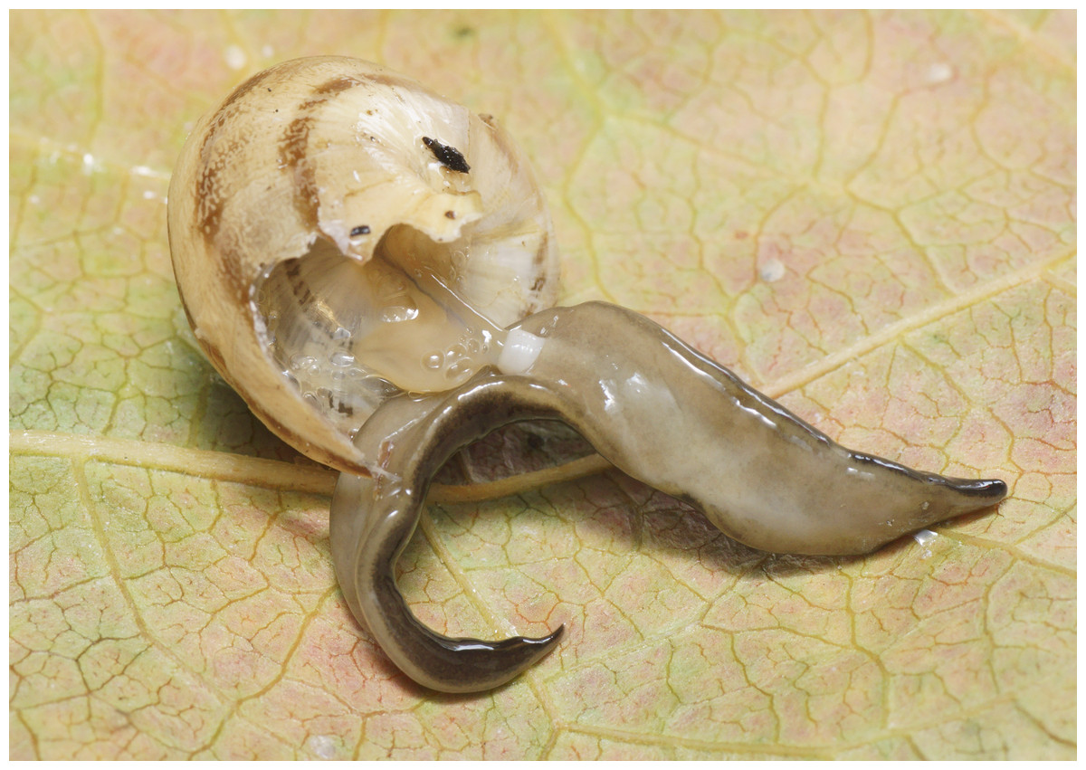
New Guinea flatworm
Platydemus manokwari
Native to: New Guinea
Host Species: Predator of snails and earthworms
How can it spread? Hitchhiked to United States in potted plants.
    Present in several states including Texas.
Identification: Resembles a leech but has no segments. Chocolate-brown with light brown stripe usually present down the backside.
Economic & Health Impacts
  Carries A. cantonensis in Hawaii and Southeast Asia.
  Reduces native land snail and beneficial earthworm populations.
    Despite earthworms being introduced, our garden and crop plants depend on their nutrient-cycling for growth.
Notes:
PRONUNCIATION:
Platydemus = Pla-tee-deh-muss
Manokwari = Ma-no-ka-war-eye
The new Guinea flatworm is a predatory land flatworm that can also spread Angiostrongylus parasites. In the Pacific Islands and Hawaii is has shown destroyed many native mollusk and invertebrate populations. This trend is being noticed in urban, suburban and rural gardens throughout the States it is established. TISI considers this flatworm well-established in the Austin, Corpus Christi, Houston, Dallas, Fort Worth and San Antonio metropolitan areas, surrounding townships and counties. DO NOT CUT UP! It can regenerate from segments because flatworms do not require sexual reproduction to grow.
TISI is actively documenting the spread of this species in TX. Go to our webpage for more information on distribution, management and how to report it http://www.tsusinvasives.org/home/database/platydemus-manokwari
PHOTOS:
Flatworm: https://doi.org/10.7717/peerj.297/fig-1
Second flatworm: Submitted by TISI Citizen Scientist
Flatworm eating a snail: https://doi.org/10.7717/peerj.297/fig-5
RESOURCES:
https://blogs.ifas.ufl.edu/indianriverco/2018/07/23/invasive-alert-meet-the-new-guinea-flatworm/
https://discover.pbcgov.org/coextension/agriculture/pdf/New%20Guinea%20flatworm%20factsheet.pdf
https://www.ksat.com/news/local/2020/08/03/invasive-worm-spotted-in-san-antonio-area-could-carry-rat-lungworm-parasite/

Slide 23

Removal Strategies
With gloved hands or stick, place as many in a sealable container
  Freeze them for 48 hrs OR place salt in sealed container and throw away.
Use organic slug bait- less toxic to domestic animals
  Iron-phosphate based baits are safer for pets, NOT Metaldehyde-based baits
Place diatomaceous earth in your yard
  This organic compound helps dry the surface-level making it inhospitable for slugs and flatworms but causes no harm to plants.
For apple snails, smash any eggs you see!!
  Destruction of adults is also encouraged but harder to achieve.

Slide 24
Managing Aquatic and Terrestrial Sites
The process for preventing the spread aquatic and terrestrial invaders are slightly different.
  When reviewing- think about what messages are repeated to the public.

Slide 25
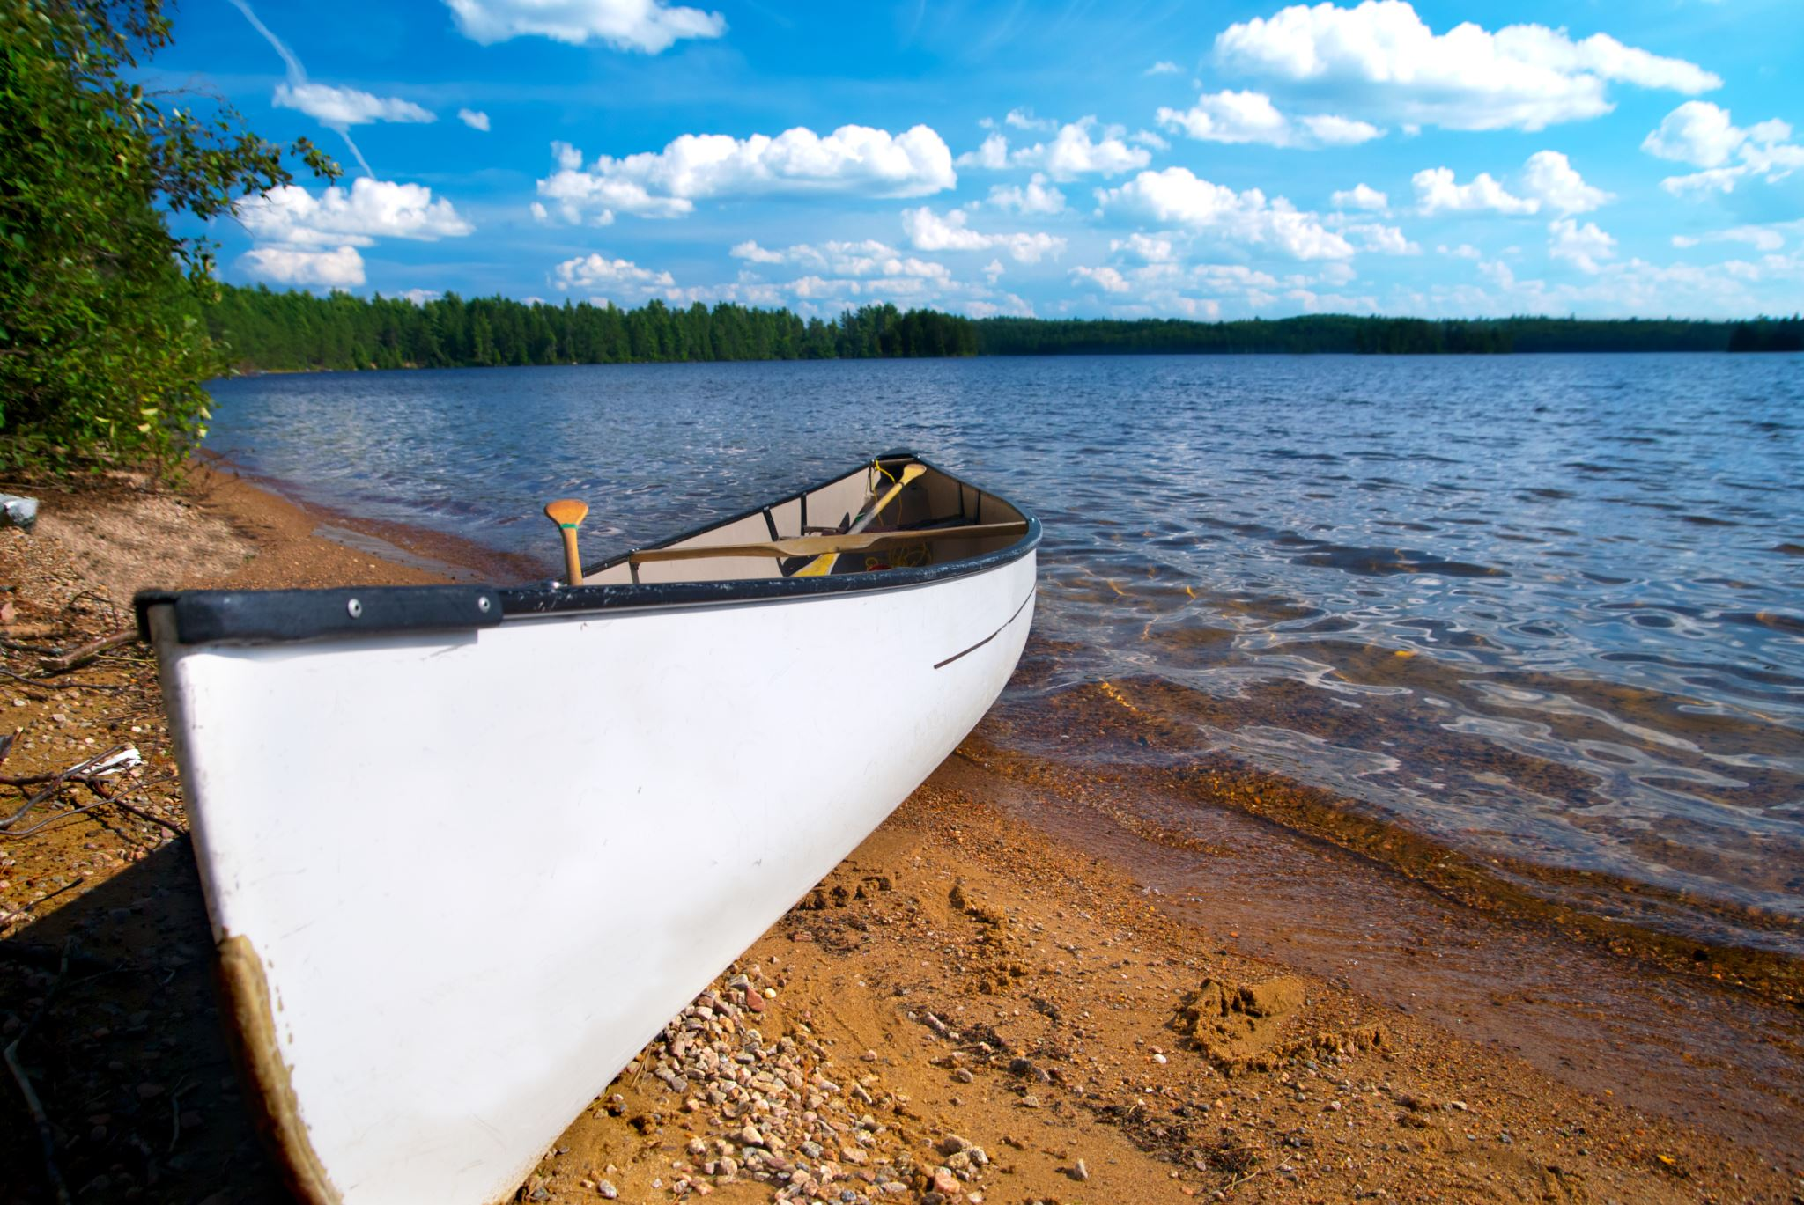
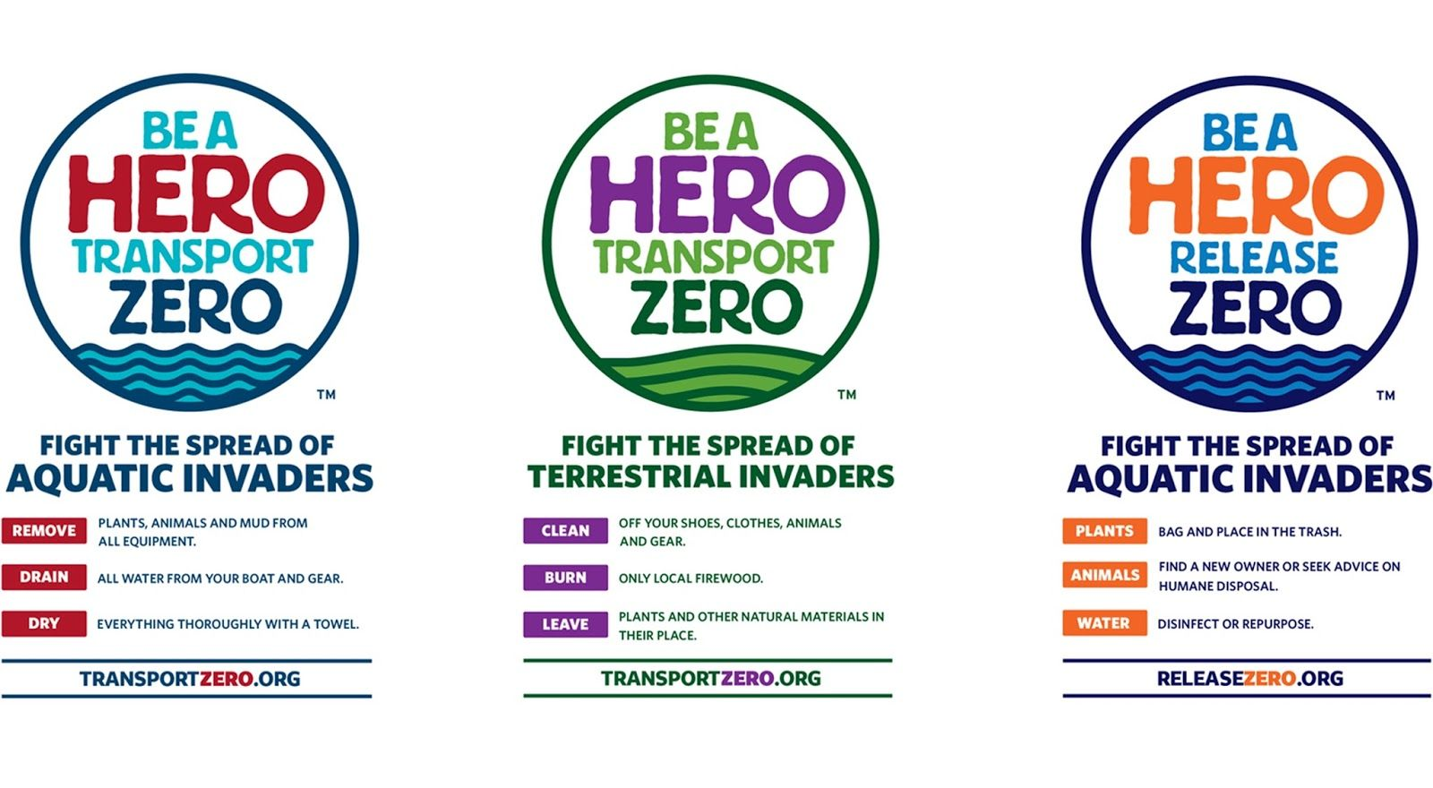

Managing Aquatic Sites
“Clean, Drain, Dry”
Notes:
As mentioned in the Zebra Mussel introduction- cleaning boating equipment is vital to prevent the spread of invasive aquatic species like Zebra & Quagga Mussels and Giant Salvinia.

Slide 26
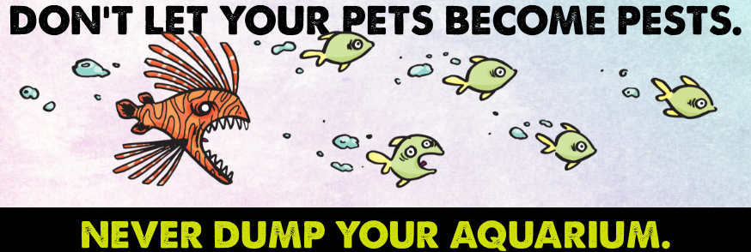
Managing Aquatic Sites
“Release Zero”
Notes:
“Releasing animals into the wild” is how Apple Snails were introduced into the US and how Florida go its HUGE Python problem.
If you go fishing- are you dumping bait fish? Worms?

Slide 27
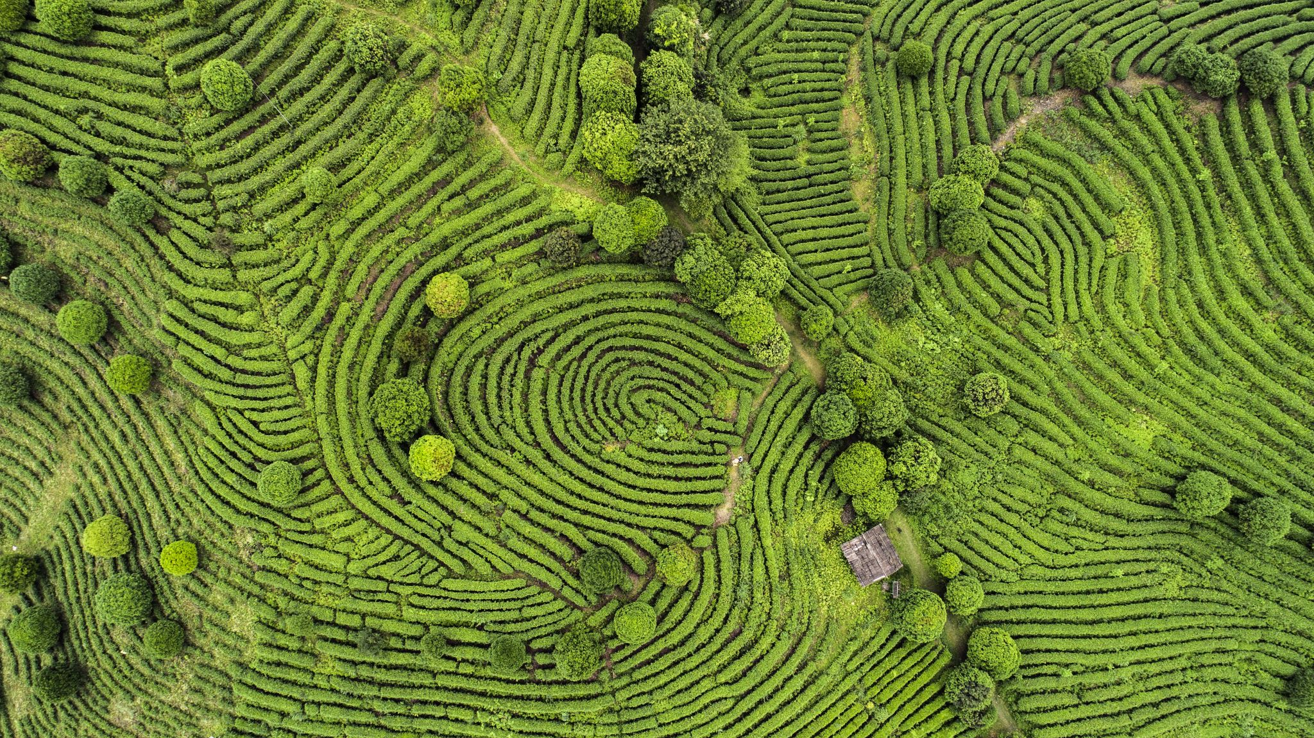


Managing Terrestrial Sites
“Leave No Trace”
Notes:
Just like you should clean your boats and aquatic equipment this is equally important in terrestrial settings.
Clean farm equipment in between fields
Clean hiking equipment when you camp
Keep your firewood local!

Slide 28
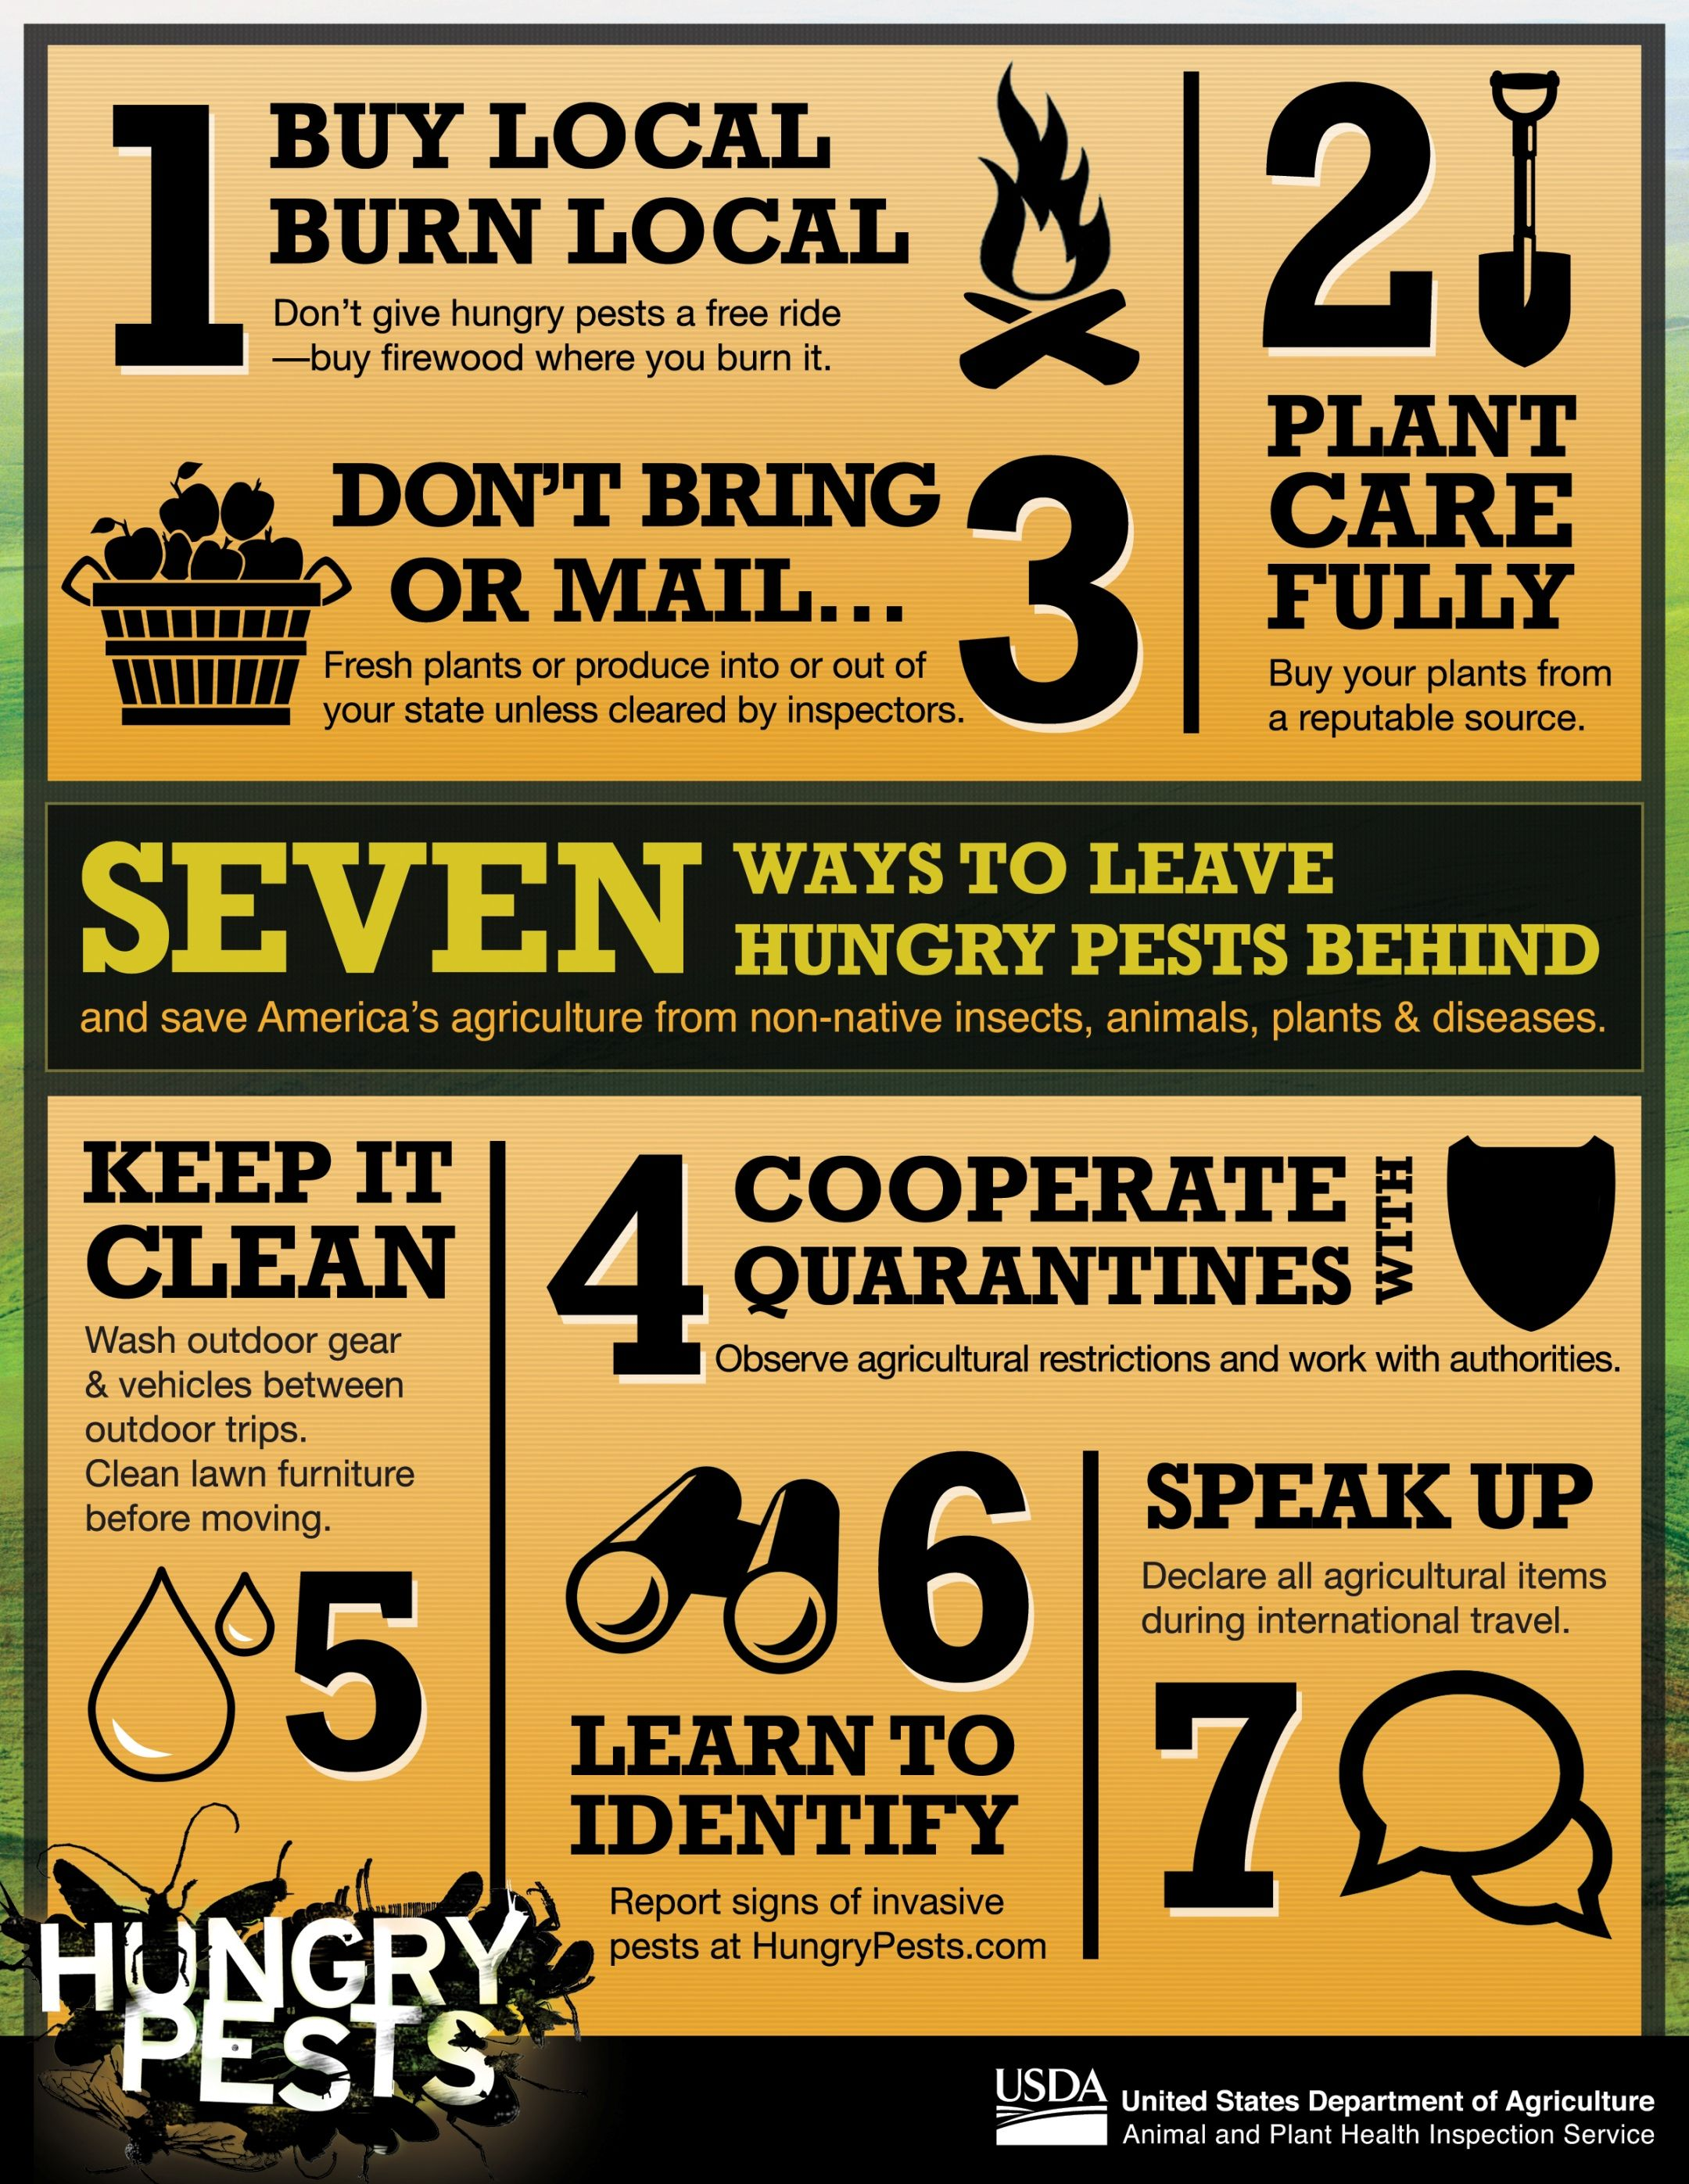
Importance of Invasive Mollusk & Crustacean Prevention
Health Concerns: Most of the species presented can spread parasites to humans, mammals and birds.
Financial Cost
  Zebra Mussels cost the US $5 Billion to remove and manage this species.
  Giant African Snail in Florida took over $38 Million to eradicate.
  Apple Snails cost rice production losses up to $1 Billion in the Philippines.
Notes:
ECONOMIC DATA:
$5 Billion estimate: https://web.archive.org/web/20140508224713/http://www.dgif.virginia.gov/wildlife/zebramussels.asp
African Snail eradication costs: https://www.aphis.usda.gov/aphis/resources/pests-diseases/hungry-pests/the-threat/giant-african-snail/giant-african-snail
Apple snail cost: https://blog.invasive-species.org/2021/09/13/apple-snail-the-threat-and-potential-economic-impacts-on-east-africa/

Slide 29
Importance of Invasive Mollusk & Crustacean Prevention
Ecosystem Concerns
Displace native species
Destroy crop and ornamental plants
  Zebra Mussels: over-consume nutrients needed for native species survival.
  New Guinea Flatworm: Is a predator of earthworms- which are needed in our garden and agricultural areas.
What can you do?
  REMOVE invasive mollusks!
  SPREAD THE WORD about not handling them.
  CLEAN your equipment!

Slide 30


Notes:
Next we’ll discuss how YOU can help prevent the spread of invasives.

